Slide 1
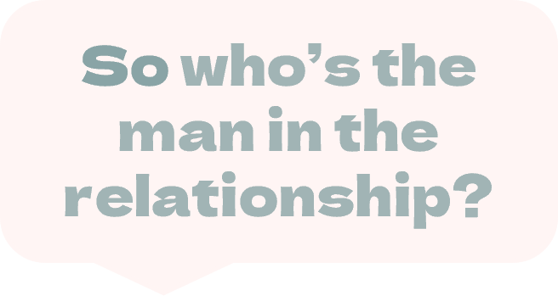
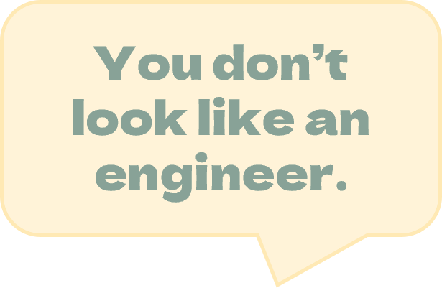
Ever said something hurtful you didn’t mean?
Unsure of how to address those situations in the workplace?
Join us to learn the skills to do better moving forward.
Sponsored by:
Session Info:
YOUR LOGO HERE
(Delete this box)
When: [insert date]
Time: [insert time]
Location: [insert location]
Other information:
[Log in details, point of contact for questions, etc.]
Presented by:
straightforequality.org

